Slide 1
VIEWS

Slide 2
INTRODUCTION
VIEWS are virtual tables .By virtual, it means, the tables do not store any data of their own but display data stored in other tables.
In other words, VIEWS are nothing but SELECT Queries.

Slide 3
VIEW PROCESSING ALGORITHMS
The algorithm attribute allows us to control which mechanism MySQL uses when creating the view. MySQL provides three algorithms: MERGE, TEMPTABLE, and UNDEFINED.
CREATE
[ALGORITHM = {MERGE | TEMPTABLE | UNDEFINED}]
VIEW view_name [(column_list)]
AS
select-statement;
MERGE algorithm: MySQL first combines the input query with the SELECT statement, which defines the view, into a single query. The MERGE algorithm is not allowed if the SELECT statement contains aggregate functions such as MIN, MAX, SUM, COUNT, AVG or DISTINCT, GROUP BY, HAVING, LIMIT, UNION, UNION ALL, subquery.
TEMPTABLE algorithm: MySQL first creates a temporary table based on the SELECT statement that defines the view, and then it executes the input query against this temporary table.
UNDEFINED algorithm: Default algorithm when we create a view without specifying an explicit algorithm

Slide 4
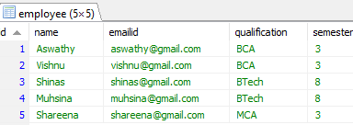
View name: A view and a table cannot have the same name.
SELECT statement: In the SELECT statement, we can query data from any table or view that exists in the database.
There are several rules that the SELECT statement must follow:
Can contain a subquery in WHERE clause but not in the FROM clause.
Cannot refer to any variables including local variables, user variables, and session variables.
Cannot refer to the parameters of prepared statements.
VIEW EXAMPLES

Slide 5
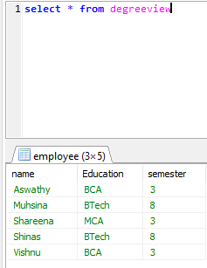
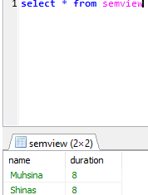
CREATE VIEW degreeview
AS
Select name, qualification
from employee group by name
~~~~~~~~~~~~~~~~~~~~~~~~~~~
Select * from degreeview
Creating a view based on another view
CREATE VIEW semview
AS
SELECT name, semester AS duration
FROM degreeview WHERE semester>3
~~~~~~~~~~~~~~~~~~~~~~~~~~~~~~
Select * from semview

Slide 6
Update VIEW
The ALTER VIEW statement is used to modify or update the already created VIEW without dropping it.
ALTER VIEW view_name AS
SELECT columns
FROM table
WHERE conditions;
Drop VIEW
DROP VIEW [IF EXISTS] view_name;

Slide 7
ADVANTAGES AND DISADVANTAGES
Advantages
Allows us to simplify complex queries
Helps limit data access to specific users
Provides extra security layer
Enables computed columns
Enables backward compatibility
Disadvantages
Performance: querying data from a database view can be slow especially if the view is created based on other views.
Tables dependency: we create a view based on underlying tables of the database. Whenever we change the structure of these tables that view associated with, we have to change the view as well.

